Slide 1


TECH BOOTCAMP
DAY 06
INTRODUCTION TO IMAGE PROCESSING AND TOOLS

Slide 2

01
INTRODUCTION TO OPENCV

Slide 3

OPEN SOURCE COMPUTER VISION LIBRARY
IMAGE PROCESSING LIBRARY
CRUCIAL IN COMPUTER VISION
MULTILINGUAL, CROSS-PLATFORM, EVOLVING
DETECTION, RECOGNITION, CALIBRATION
ACTIVE, RESOURCE-RICH COMMUNITY

Slide 4
02
INSTALLATION

Slide 5



OFFICIAL WEBSITE
https://opencv.org/
AVAILABLE FOR

Slide 6
03
BASIC
IMAGE OPERATIONS

Slide 7
LOAD IMAGE
cv2.imread('path_to_image.jpg')

Slide 8
DISPLAY IMAGE
cv2.imshow('Loaded Image', image)

Slide 9
SAVE IMAGE
cv2.imwrite('saved_image.jpg', image)

Slide 10
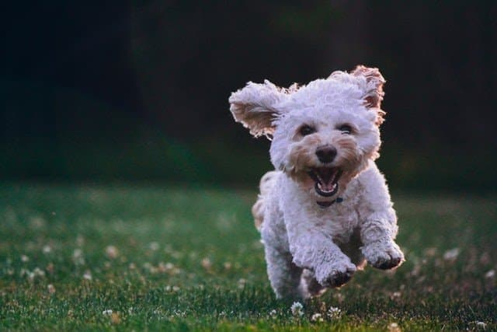
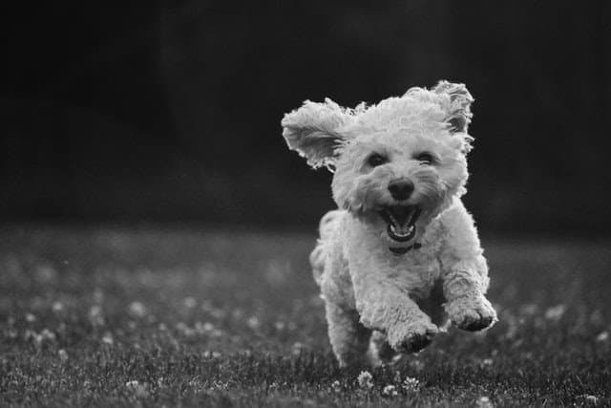
IMAGE TO GREYSCALE
cv2.cvtColor(image, cv2.COLOR_BGR2GRAY)

Slide 11

RESIZE IMAGE
cv2.resize(image, (500, 500))
640 PX
500 PX
427 PX
500 PX

Slide 12
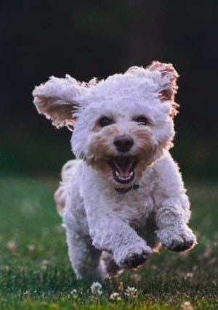
CROP IMAGE
image[y:y+h, x:x+w]
ORIGIN

Slide 13
04
IMAGE FILTERING

Slide 14
BLURRING
AVERAGE BLURRING
GAUSSIAN BLURRING
MEDIAN BLURRING

Slide 15

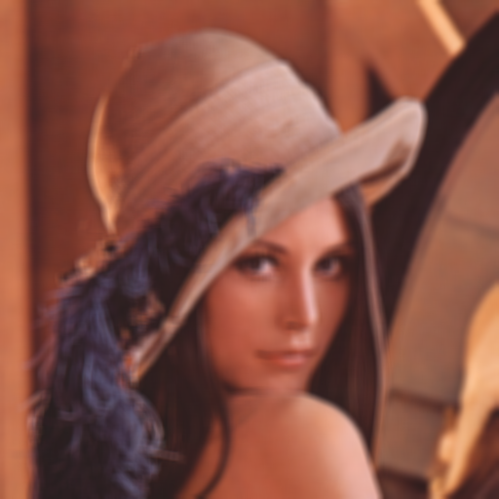
AVERAGE BLURRING
blurred_image = cv2.blur(image, (9, 9))

Slide 16

GAUSSIAN BLURRING
gaussian_blurred_image = cv2.GaussianBlur(image, (9, 9), 0)

Slide 17

MEDIAN BLURRING
median_blurred_image = cv2.medianBlur(image, 9)

Slide 18

SHARPENING
cv2.filter2D(image, -1, kernel)

Slide 19
EDGE DETECTION
SOBEL EDGE DETECTION
LAPLACIAN EDGE DETECTION
CANNY EDGE DETECTION

Slide 20
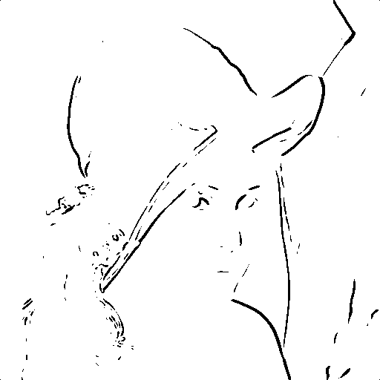
SOBEL EDGE DETECTION
cv2.Sobel(image, cv2.CV_64F, 1, 0, ksize=5)

Slide 21
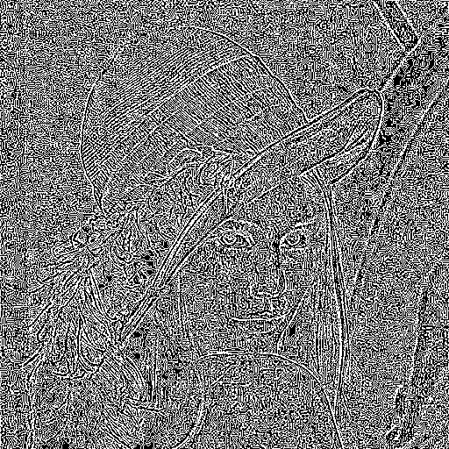
LAPLACIAN EDGE DETECTION
cv2.Laplacian(image, cv2.CV_64F)

Slide 22
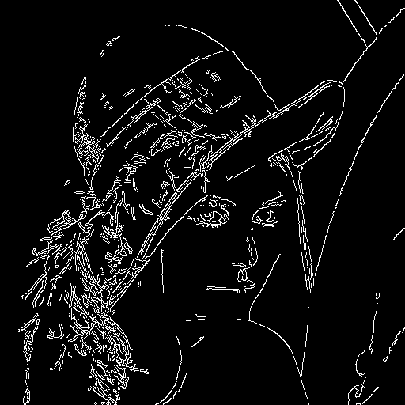
CANNY EDGE DETECTION
cv2.Canny(image, 100, 200)

Slide 23
05
IMAGE TRANSFORMATIONS

Slide 24
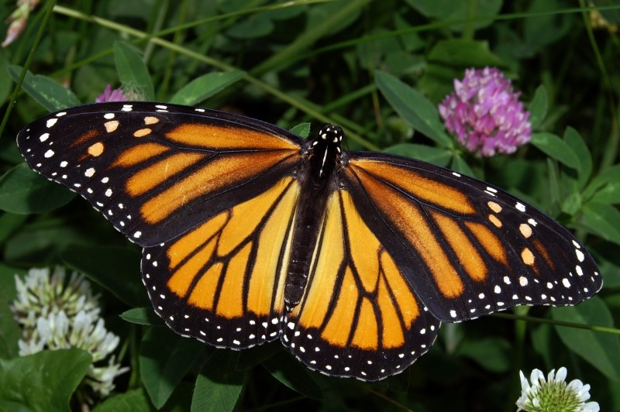

RESIZING
cv2.resize(image, (image.shape[1] // 2, image.shape[0] // 2))

Slide 25

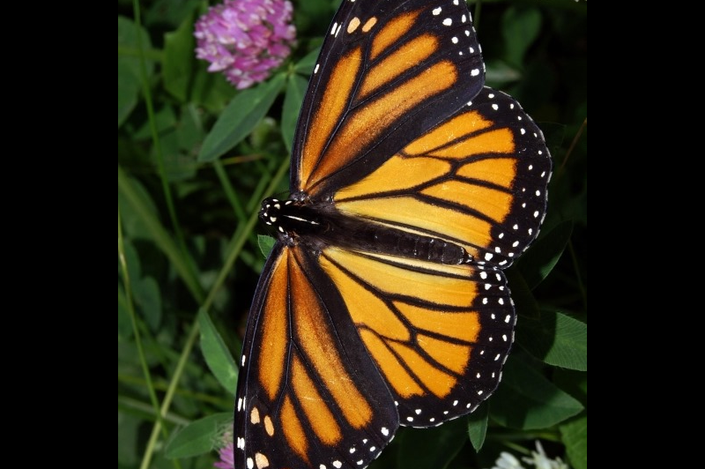
ROTATING
cv2.getRotationMatrix2D(center, angle, scale)
cv2.warpAffine(image, rotation_matrix, (w, h))

Slide 26
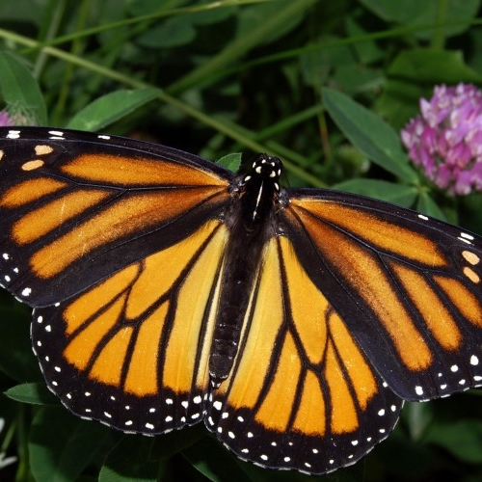
CROPPING
image[y:y+h, x:x+w]

Slide 27
06
OBJECT DETECTION

Slide 28
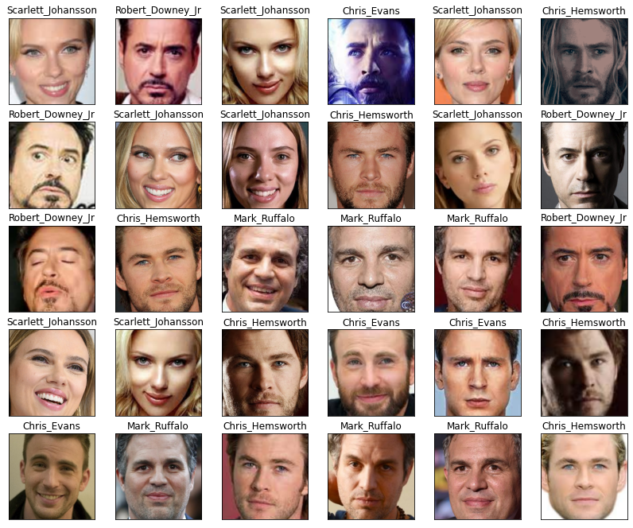
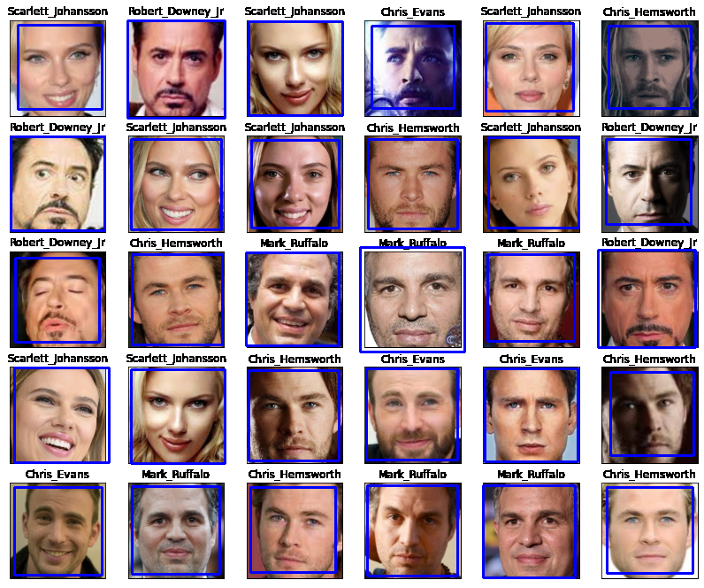
HAAR CASCADE CLASSIFIER
cv2.CascadeClassifier(cv2.data.haarcascades + 'haarcascade_frontalface_default.xml')

Slide 29
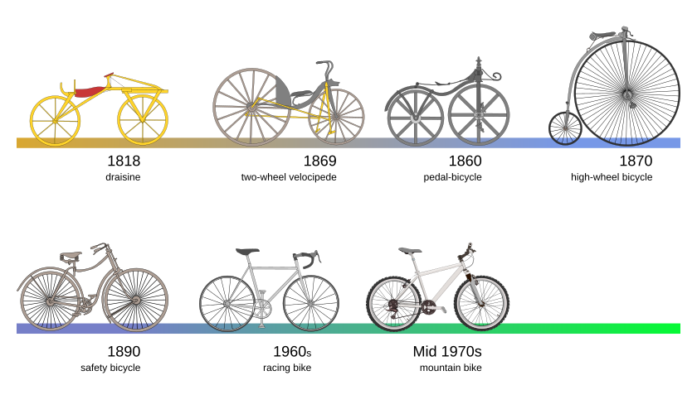
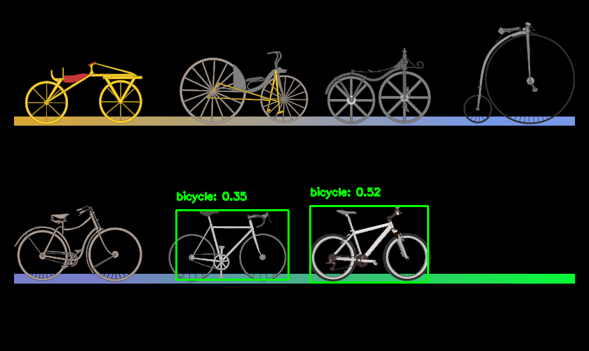
PRE-TRAINED DEEP LEARNING MODEL
cv2.dnn.readNetFromCaffe('path_to_deploy.prototxt’, 'path_to_model.caffemodel')

Slide 30
07
IMAGE PROCESSING TECHNIQUES

Slide 31
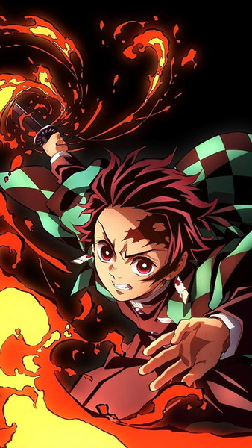
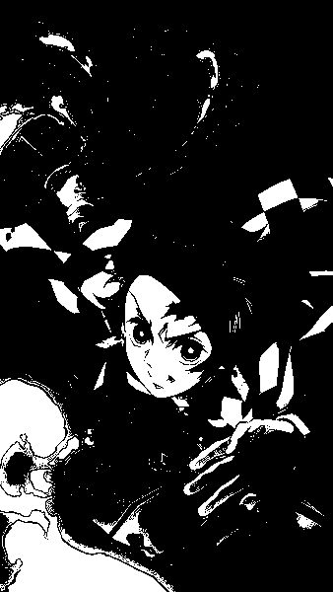
THRESHOLDING
cv2.threshold(image, 127, 255, cv2.THRESH_BINARY)

Slide 32
MORPHOLOGICAL OPERATIONS
DILATION
EROSION
OPENING AND CLOSING

Slide 33
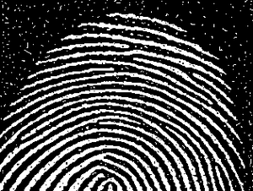
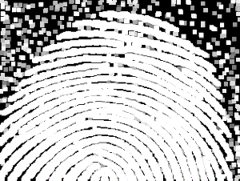
DILATION
cv2.dilate(image, kernel, iterations=1)

Slide 34

EROSION
cv2.erode(image, kernel, iterations=1)

Slide 35
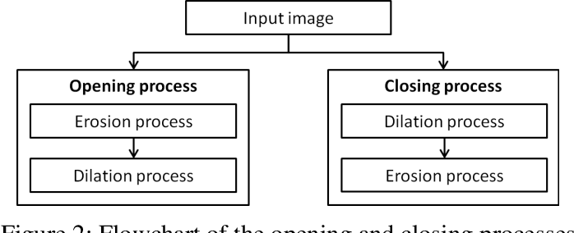
OPENING AND CLOSING
cv2.morphologyEx(image, cv2.MORPH_OPEN, kernel)
cv2.morphologyEx(image, cv2.MORPH_CLOSE, kernel)

Slide 36
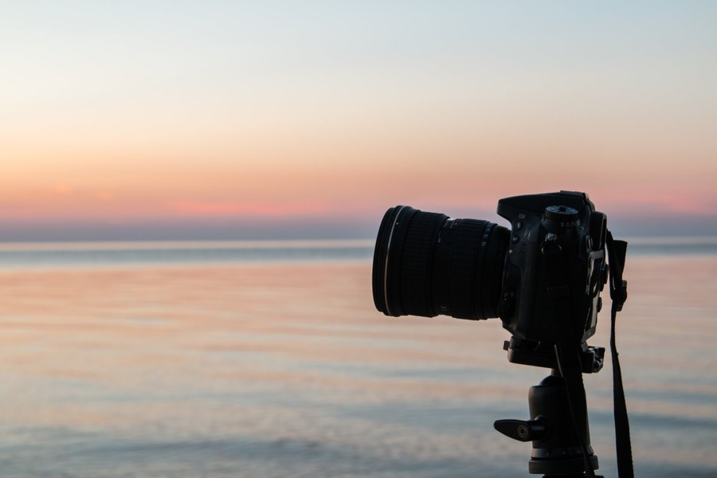
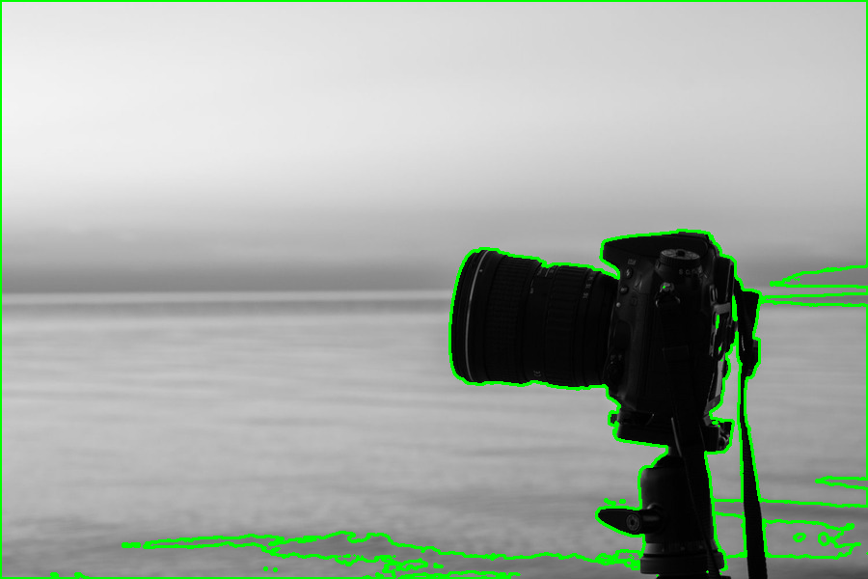
CONTOUR DETECTION
cv2.findContours(binary_image, cv2.RETR_TREE, cv2.CHAIN_APPROX_SIMPLE)

Slide 37
08
PRACTICAL EXAMPLES

Slide 38
1/5
How do you load an image in grayscale and display it using OpenCV?
HINT

Slide 39
2/5
How can you resize an image to 200x200 pixels?
HINT

Slide 40
3/5
How do you convert a colored image to a binary image using a threshold value of 127?
HINT

Slide 41
4/5
How can you detect edges in an image using the Canny edge detector?
HINT

Slide 42
5/5
How do you detect and draw contours on a binary image?
HINT

Slide 43
TECH BOOTCAMP
DAY 06
INTRODUCTION TO IMAGE PROCESSING AND TOOLS
THANK YOU!

